Slide 1
Hybrid Attack Illustration Figures
Transfer Attack
Gradient Attack
Search gradient calculated w.r.t local models
tune local models
(test, label) by-products
Target Region
White-box attack using local models
Gradient attacks on target model with estimated gradient from queries
Failed Local AE
Input Image
M₁
M₂
M₃
Local AE
Successful Adversarial Example
AE
Collect (test, label) pairs and tune local models
Target Model
(API Only)
Input Seed
Search gradient estimated from target model queries
Attack Process of Hybrid Attack
Search Space of Hybrid Attack

Slide 2
Local Candidate Results
Model | Success Rate (%) |  | Queries/AE |  | Fraction Better (%)
 | Base | Ours | Base | Ours
CIFAR10 Robust (Untargeted) | 64.4 | 65.2 | 2,640 | 2,529 | 74.4
Model | Success Rate (%) |  | Queries/AE |  | Fraction Better (%)
 | Base | Ours | Base | Ours
MNIST Normal (Targeted) | 90.9 | 98.8 | 1,645 | 298 | 99.8
CIFAR10 Normal (Targeted) | 92.2 | 98.1 | 1,227 | 277 | 98.7
ImageNet Normal (Targeted) | 93.6 | 97.2 | 42,417 | 24,104 | 91.8

Slide 3
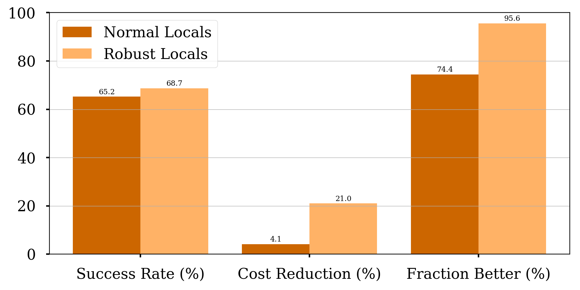
Results of local models

Slide 4
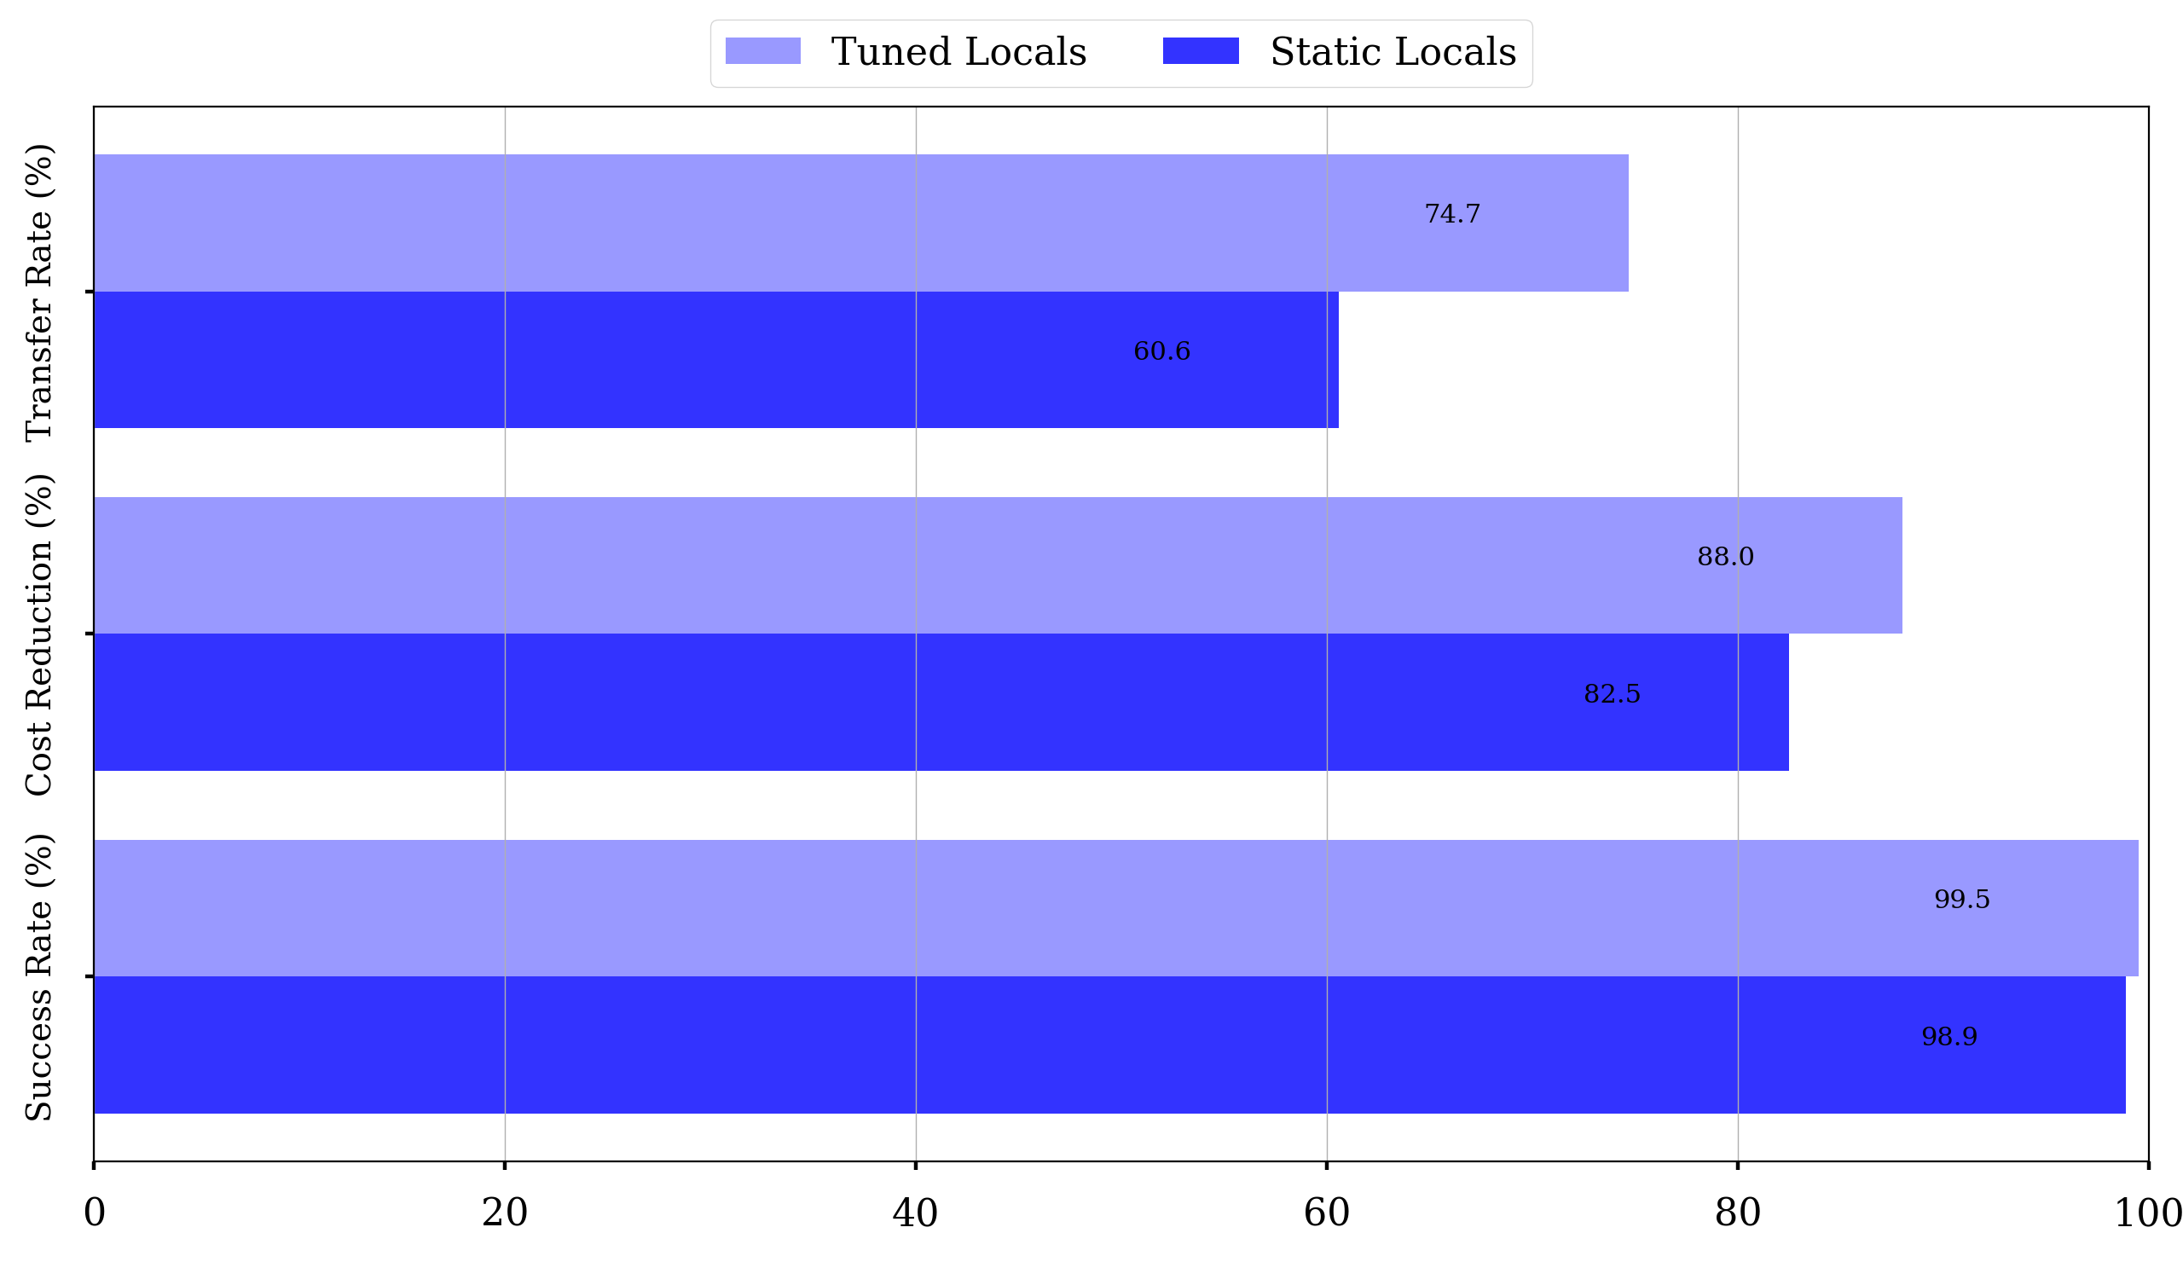
Fine-tuning

Slide 5
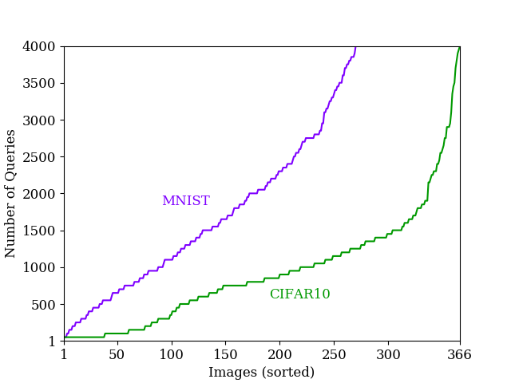
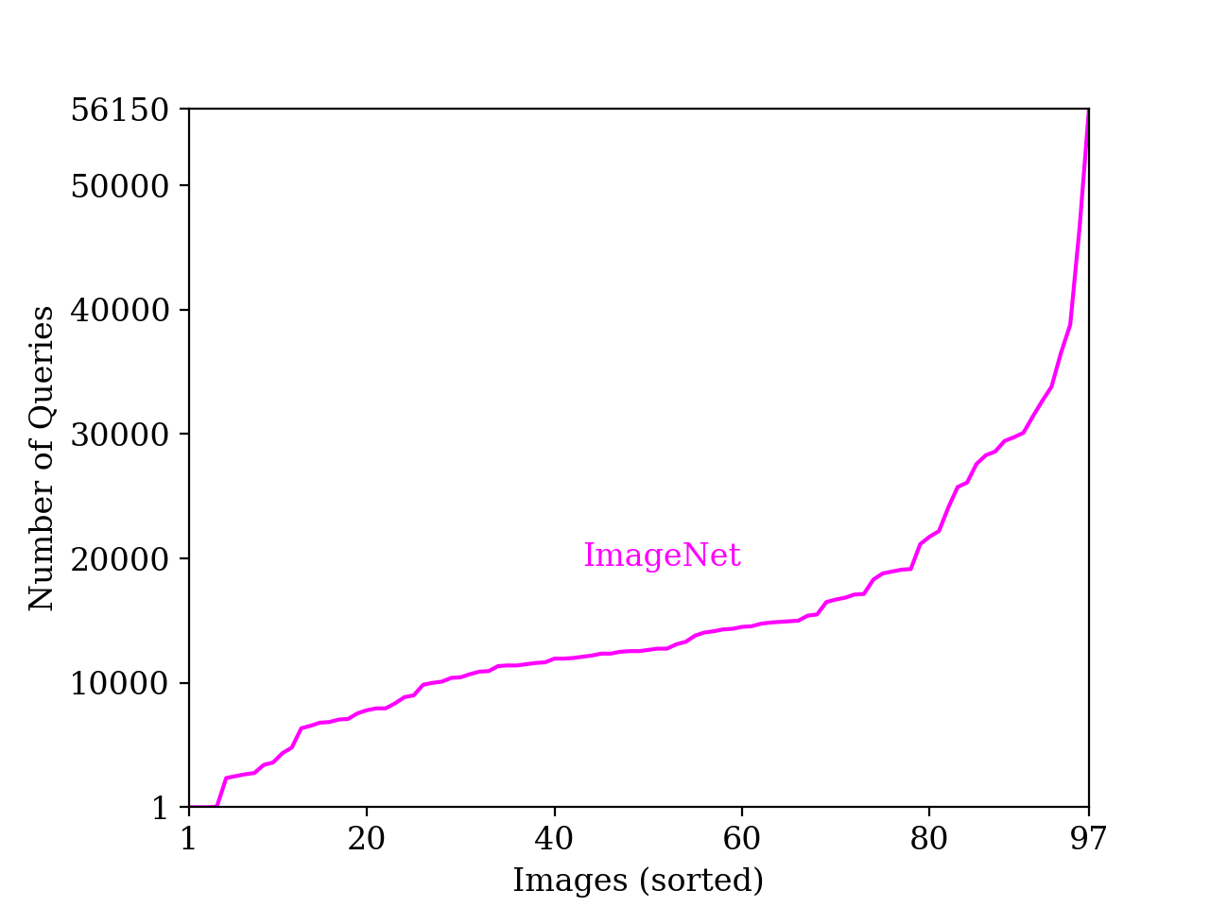
Query Distribution

Slide 6
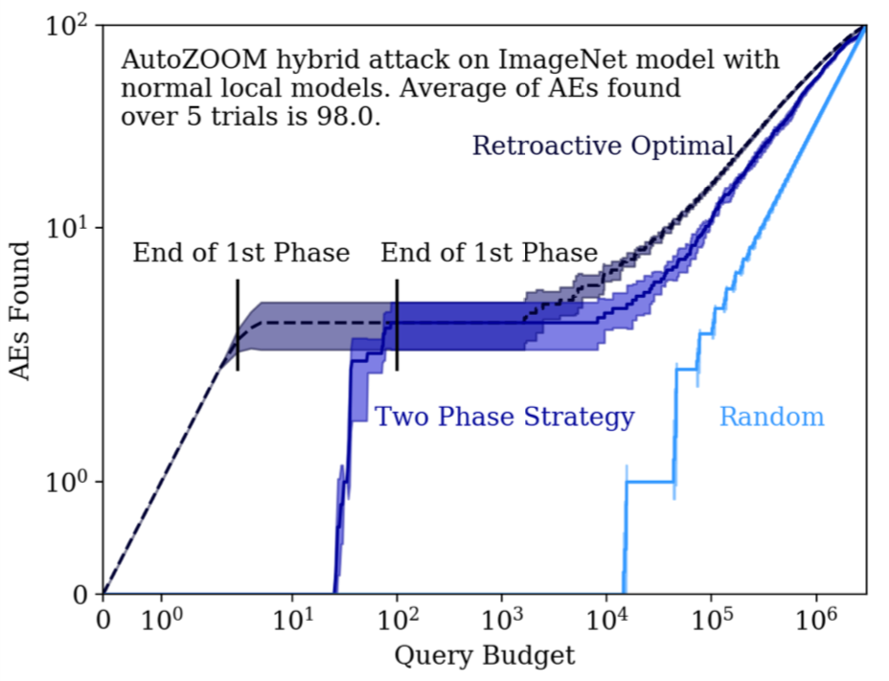
Batch Attack Results

Slide 7
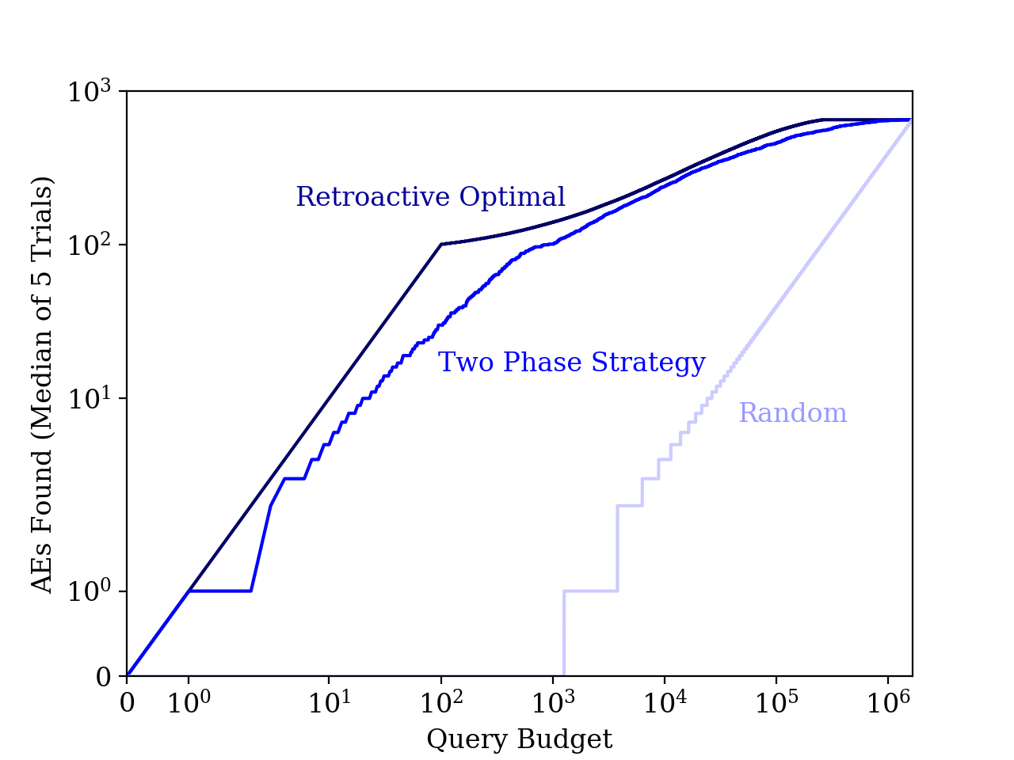
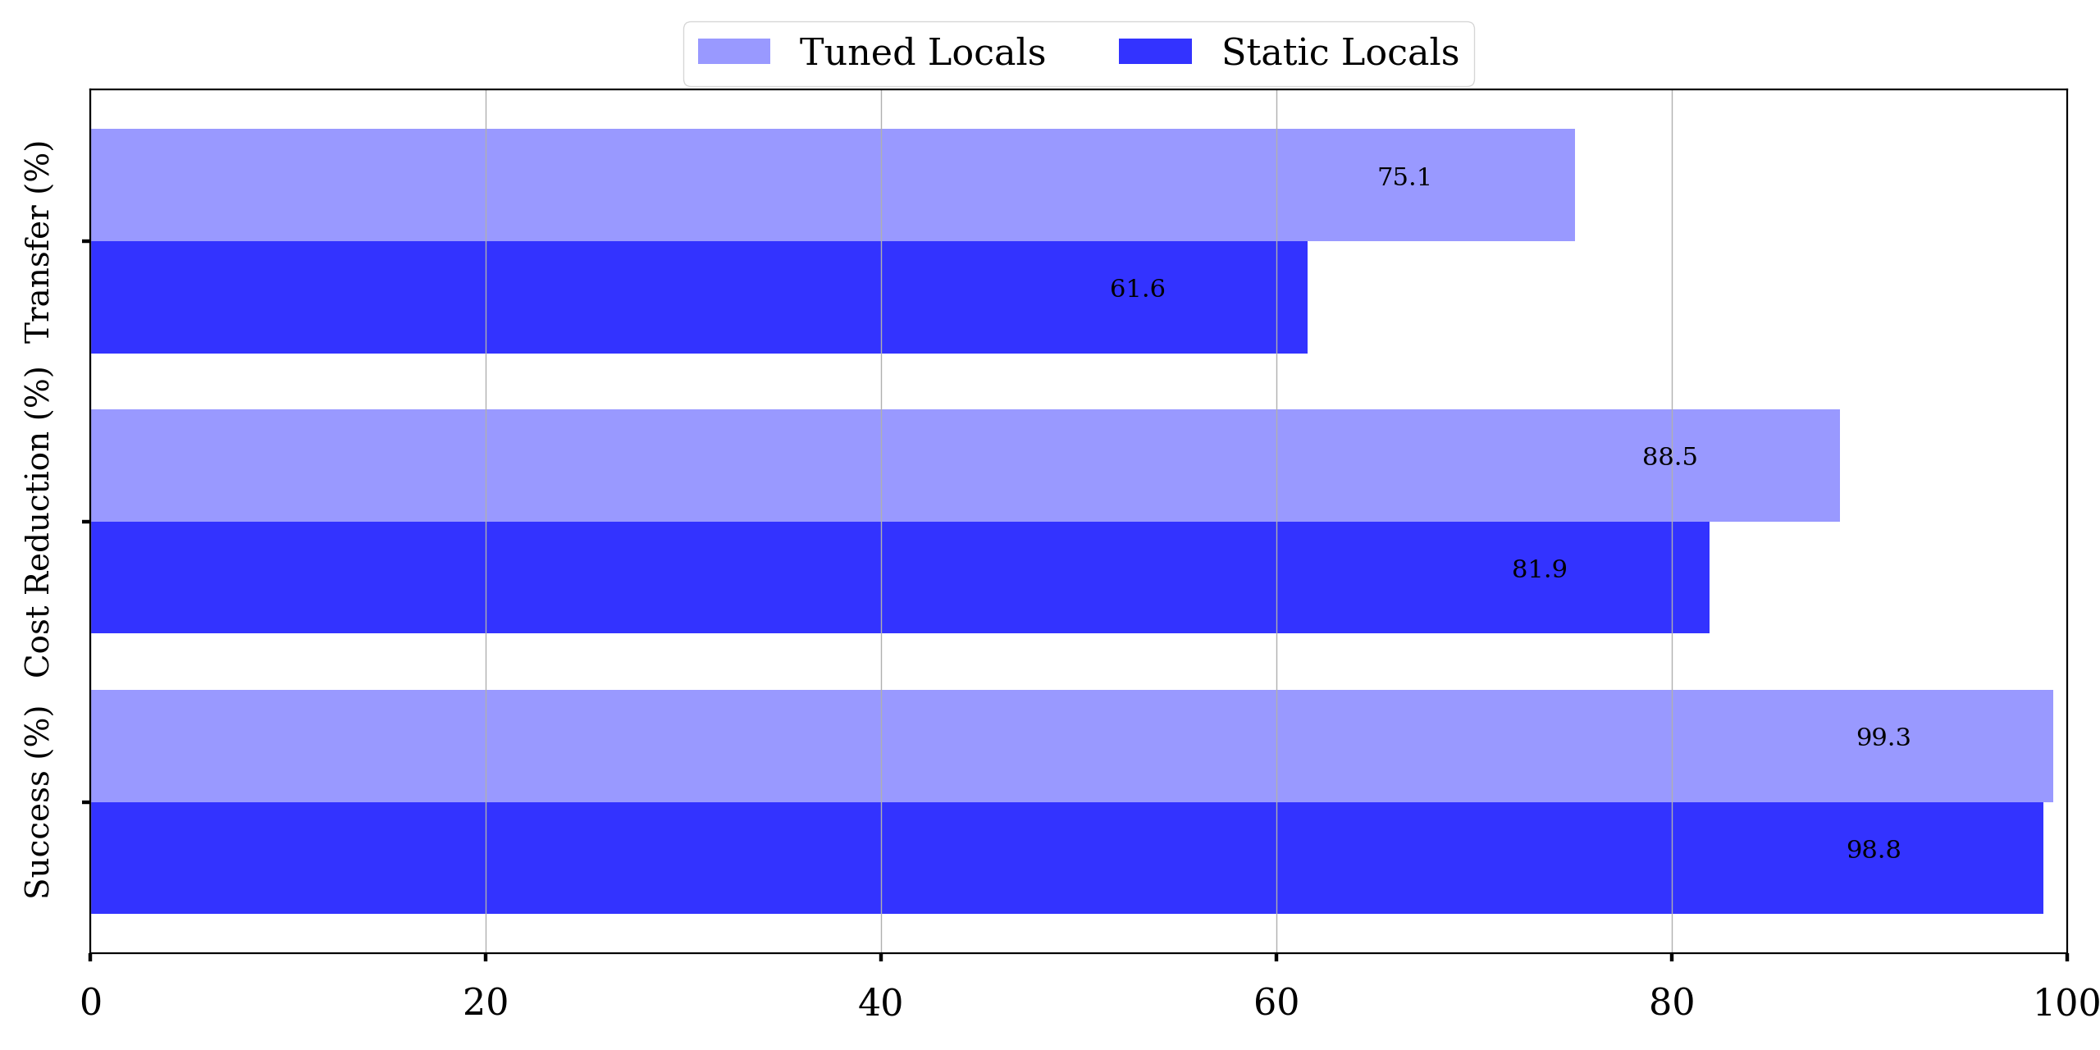
Hybrid Batch Attacks: Finding Black-box Adversarial Examples with Limited Queries Fnu Suya, Jianfeng Chi, David Evans, Yuan Tian USENIX Security Symposium 2020
Goal: Estimate the cost for a black-box adversary to find adversarial examples.
Does it help gradient attacks to start from failed transfer candidates?
Batch Attack
Can we do better when total query is limited?
Combining Transfer and Gradient Attacks
Model | Success Rate (%) |  | Queries/AE |  | Fraction Better (%)
 | Base | Ours | Base | Ours
MNIST Normal (Targeted) | 90.9 | 98.8 | 1,645 | 298 | 99.8
CIFAR10 Normal (Targeted) | 92.2 | 98.1 | 1,227 | 277 | 98.7
ImageNet Normal (Targeted) | 93.6 | 97.2 | 42,417 | 24,104 | 91.8
Hybrid Batch Attack
Transfer Attack
Gradient Attack
Goal: prioritize low-cost-to-attack seeds
Two Phase Strategy:
First phase: find direct transfers by sorting images based on local PGD-Steps
Second phase: find easy images by sorting based on target model attack loss
tune local models
(test, label) by-products
White-box attack using local models
Gradient attacks on target model with estimated gradient from queries
Input Image
M₁
M₂
M₃
Local AE
Successful Adversarial Example
Target Model
(API Only)
Attack Process
CIFAR10 Robust (Untargeted) | 64.4 | 65.2 | 2,640 | 2,529 | 74.4
Search Space of Transfer Attack
Process of Transfer Attack
AutoZOOM [AAAI 2018] gradient attack, local models: normal models
Evaluating Hybrid Batch Attack
Impact of local models:
search gradient calculated w.r.t local models
652
Local AE
Target Region
Input
Image
White-box attacks on local models
Local AE
End of first phase
End of first phase
Input Seed
Search Space of Gradient Attack
Process of Gradient Attack
search gradient estimated from target model queries
Input Image
Gradient attacks on target model with estimated gradient from queries
AE
AE
Target Region
Using Byproducts to Tune Local Models
...
AutoZOOM gradient attack on robust CIFAR10 model, local models are normal models
Input Seed
query
predict
query
predict
Target Model
Number of queries to obtain 10% of 1000 seeds:
Optimal: 100; Two-Phase: 824; Random: 251,682
search gradient calculated w.r.t local models
Failed Local AE
Target Region
AE
Collect (Test, Label) pairs and tune local models
Input Seed
search gradient estimated from target model queries
To attack MNIST models, tuning the local models helps to improve the attack performance. However, for CIFAR10 models, we observe degradation of attack performance by tuning the local models.
NSF Center for Trustworthy Machine Learning
https://ctml.psu.edu/
Search Space of Hybrid Attack

